Slide 1

7th Grade Accelerated Grade
Unit 1, Lesson 5 Solving Mathematical and Real-World Problems With Equations Volume 1, pg. 29

Slide 2


Benchmark
MA.7.AR.2.2
Write and solve two-step equations in one variable within a mathematical context or real-world context, where all terms are rational numbers.
volume 1, pg. 29

Slide 3
Integrated Mathematical Thinking and Reasoning Standards
MA.K12.MTR.1.1 Actively participate in effortful learning both individually and collectively.
MA.K12.MTR.2.1 Demonstrate understanding by representing problems in multiple ways.
MA.K12.MTR.3.1 Complete tasks with mathematical fluency.
MA.K12.MTR.4.1 Engage in discussions that reflect on the mathematical thinking of self and others.
MA.K12.MTR.5.1 Use patterns and structure to help understand and connect mathematical concepts.
MA.K12.MTR.6.1 Assess the reasonableness of solutions.
volume 1, pg. 29

Slide 4

Learning Targets
I can solve two-step equations involving the distributive property.
I can solve two-step equations within a real-world context.
I can relate the solution of an equation representing a real-world context to the context.
volume 1, pg. 29

Slide 5

Warm-Up
volume 1, pg. 30

Slide 6
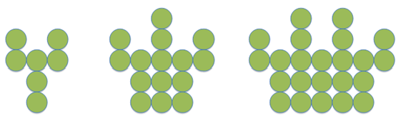
1.5.1 Warm-Up: Number Patterns
A pattern is shown.
1. Describe how the pattern is changing in each step.
2. How many circles will be in the next step?
volume 1, pg. 30

Slide 7

Refresher
volume 1, pg. 30

Slide 8

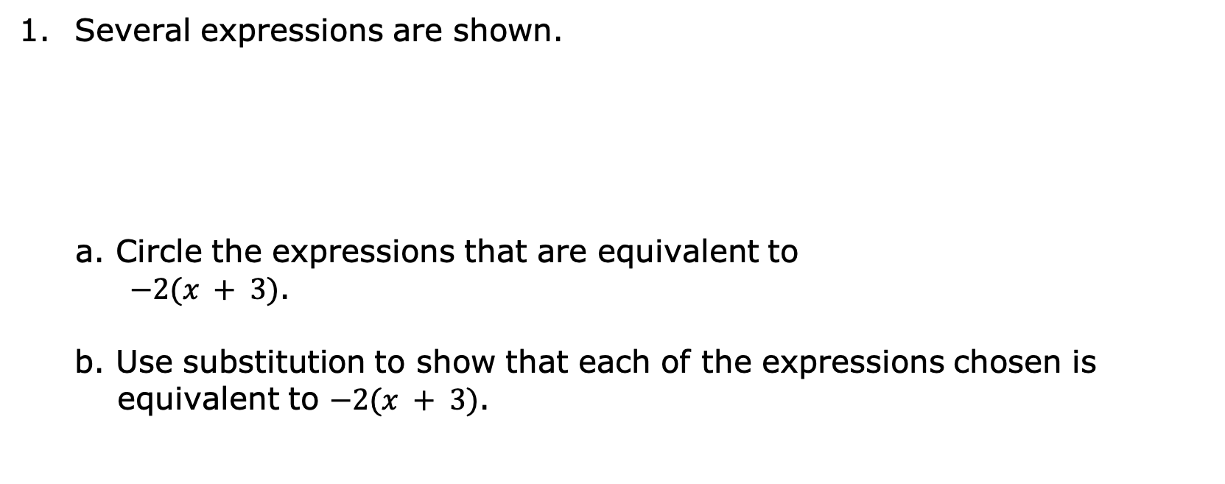
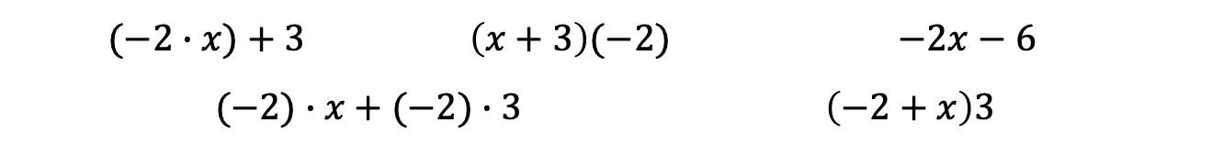
1.5.2 Refresher: The Distributive Property
Several expressions are shown.
a. Circle the expressions that are equivalent to
$−2(x + 3)$.
b. Use substitution to show that each of the expressions chosen is equivalent to $−2(x + 3)$.
$$(−2∙x)+3$$ | $$\left(x+3\right)(−2)$$ |  | $$−2x−6$$
$$(−2)∙x+(−2)∙3$$ |  | $$\left(−2+x\right)3$$
volume 1, pg. 30

Slide 9

2. Rewrite each expression by applying the distributive property.
a. $\left(−x + 6\right)4$
b. $−3.5\left(−7 + 2y\right)$
c. $\frac{7}{8}\left(16m−\frac{4}{5}\right)$
volume 1, pg. 30

Slide 10

Guided Instruction
volume 1, pg. 31

Slide 11
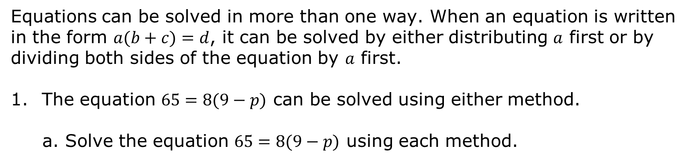
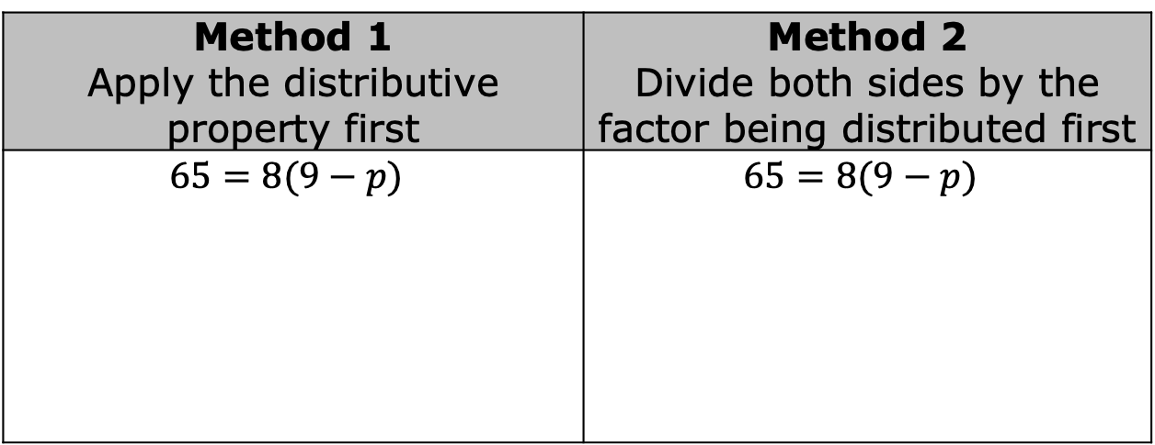
1.5.3 Guided Instruction: Solving Equations Involving the Distributive Property
Equations can be solved in more than one way. When an equation is written in the form $a(b+c)=d$, it can be solved by either distributing $a$ first or by dividing both sides of the equation by $a$ first.
The equation $65=8(9−p)$ can be solved using either method.
a. Solve the equation $65=8(9−p)$ using each method.
Method 1 Apply the distributive property first | Method 2 Divide both sides by the factor being distributed first
$$65=8(9−p)$$ | $$65=8(9−p)$$
volume 1, pg. 31

Slide 12
b. Verify the solution is correct using substitution.
c. Discuss each method of solving the equation with your partner. Then, explain which method you preferred for solving this equation.
volume 1, pg. 31

Slide 13
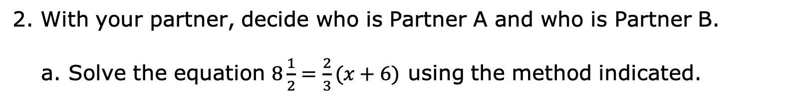
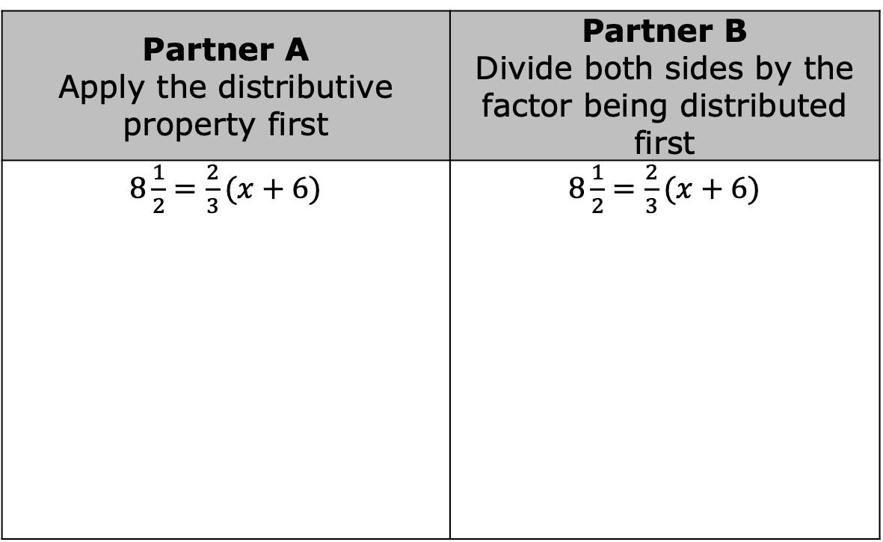
2. With your partner, decide who is Partner A and who is Partner B.
a. Solve the equation $8\frac{1}{2}=\frac{2}{3}(x+6)$ using the method indicated.
Partner A Apply the distributive property first | Partner B Divide both sides by the factor being distributed first
$8\frac{1}{2}=\frac{2}{3}(x+6)$ | $8\frac{1}{2}=\frac{2}{3}(x+6)$
volume 1, pg. 32

Slide 14
b. Share your solution and your work with your partner. Correct any errors, if necessary. Then, write your partner’s method in the space provided once both partners agree the work is correct.
c. Explain which method you preferred for solving this equation.
volume 1, pg. 32

Slide 15
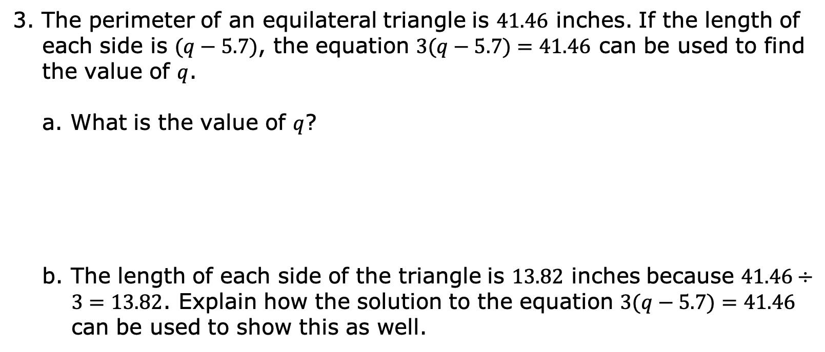
3. The perimeter of an equilateral triangle is $41.46$ inches. If the length of each side is $(q−5.7)$, the equation $3(q−5.7)=41.46$ can be used to find the value of $q$.
a. What is the value of $q$?
b. The length of each side of the triangle is $13.82$ inches because $41.46÷3=13.82$. Explain how the solution to the equation $3(q−5.7)=41.46$ can be used to show this as well.
volume 1, pg. 32

Slide 16

Collaboration
volume 1, pg. 33

Slide 17

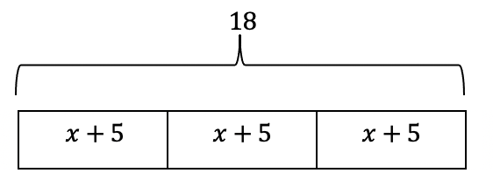
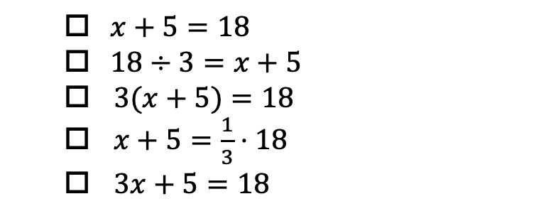
1.5.4 Collaboration: Matching Equations to Diagrams and Contexts
Equations can be represented using bar diagrams.
A bar diagram is shown.
a. Select all the equations that match the diagram.
$x+5=18$
$18÷3=x+5$
$3(x+5)=18$
$x+5=\frac{1}{3}⋅18$
$3x+5=18$
volume 1, pg. 33

Slide 18
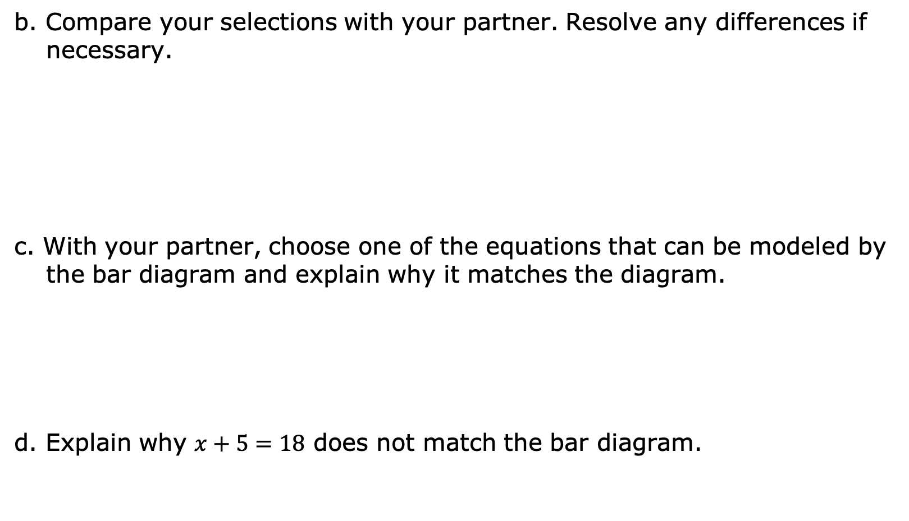
b. Compare your selections with your partner. Resolve any differences if necessary.
c. With your partner, choose one of the equations that can be modeled by the bar diagram and explain why it matches the diagram.
d. Explain why $x+5=18$ does not match the bar diagram.
volume 1, pg. 33

Slide 19
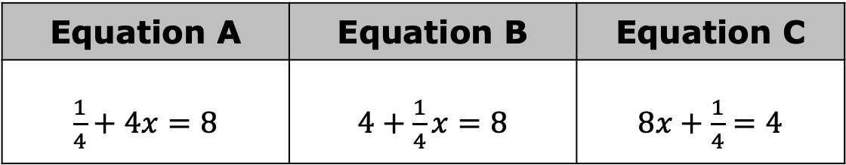
Equations can be used to represent real-world contexts.
2. Three equations are shown.
Equation A | Equation B | Equation C
$\frac{1}{4}+4x=8$ | $4+\frac{1}{4}x=8$ | $8x+\frac{1}{4}=4$
volume 1, pg. 33

Slide 20
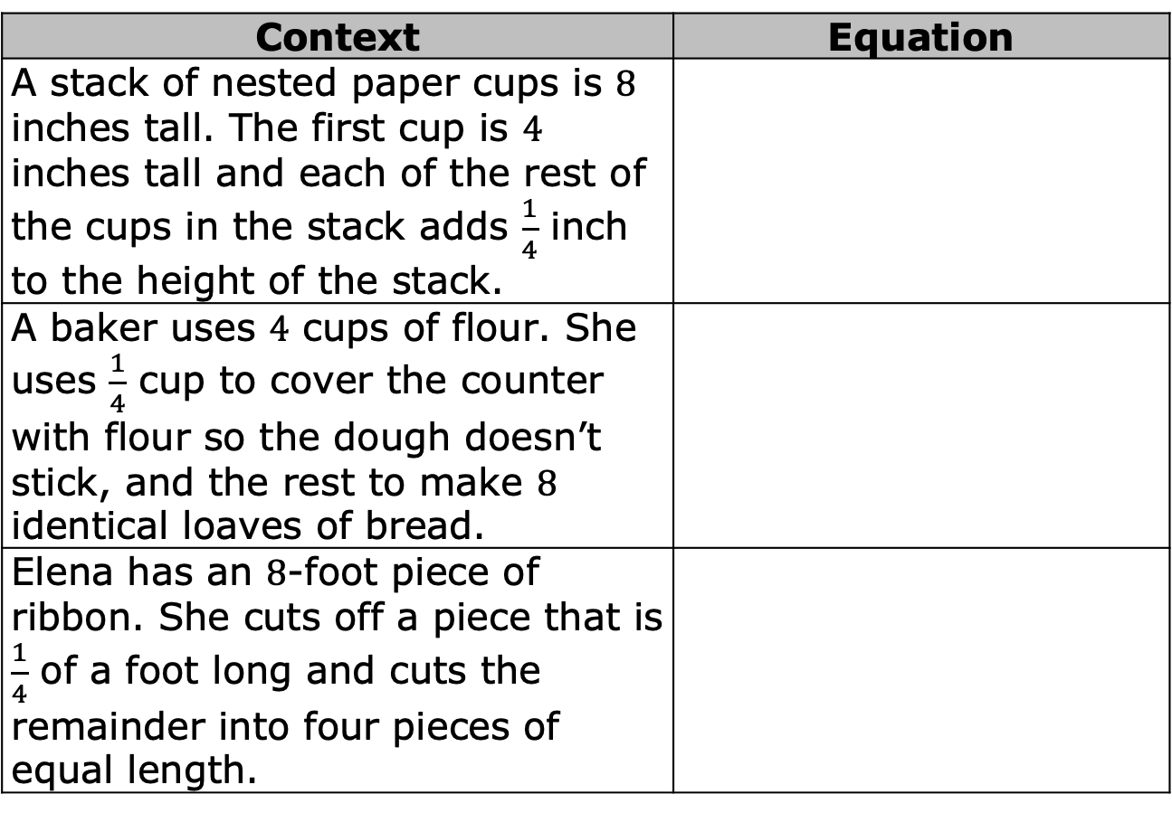
a. Work with your partner to determine which equation matches each context. Then, write each equation in the appropriate row.
Context | Equation
A stack of nested paper cups is $8$ inches tall. The first cup is $4$ inches tall and each of the rest of the cups in the stack adds $\frac{1}{4}$ inch to the height of the stack.
A baker uses $4$ cups of flour. She uses $\frac{1}{4}$ cup to cover the counter with flour so the dough doesn’t stick, and the rest to make $8$ identical loaves of bread.
Elena has an $8$-foot piece of ribbon. She cuts off a piece that is $\frac{1}{4}$ of a foot long and cuts the remainder into four pieces of equal length.
volume 1, pg. 33

Slide 21
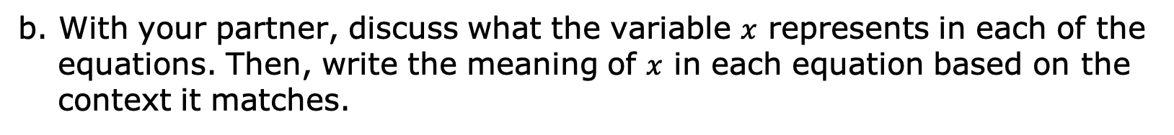
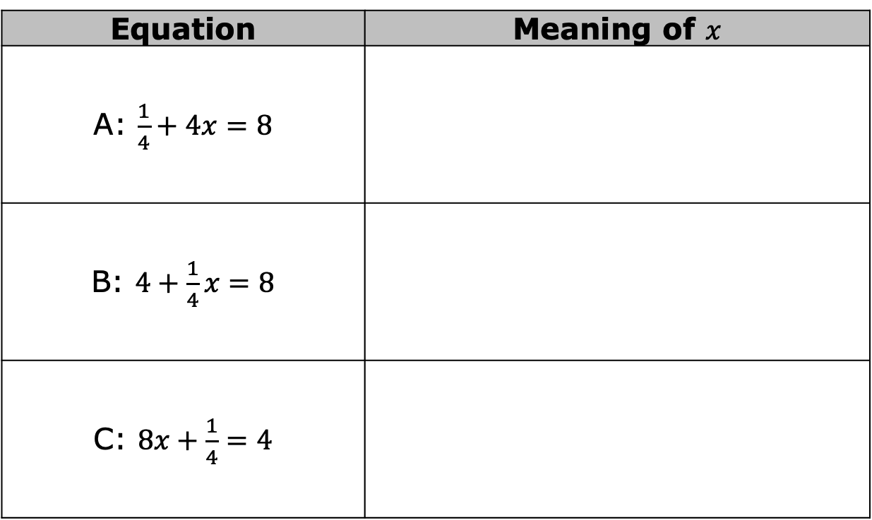
b. With your partner, discuss what the variable $x$ represents in each of the equations. Then, write the meaning of $x$ in each equation based on the context it matches.
Equation | Meaning of $x$
A: $\frac{1}{4}+4x=8$
B: $4+\frac{1}{4}x=8$
C: $8x+\frac{1}{4}=4$
volume 1, pg. 34

Slide 22
Guided Instruction
volume 1, pg. 34

Slide 23
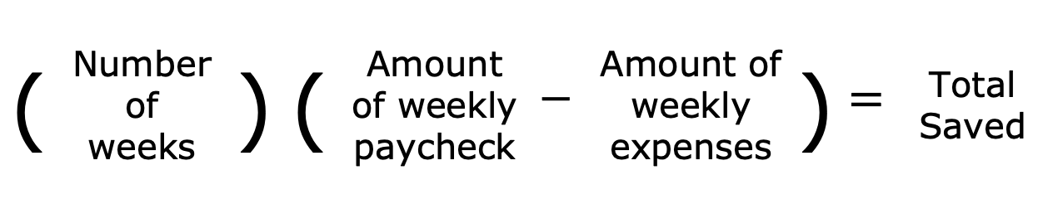
1.5.5 Guided Instruction: Relating Equations to Their Contexts
1. Franco is saving money to take a trip to Cocoa Beach, Florida with his friends. Every week, he sets aside the same portion of his paycheck after taking out the $325 he needs for his weekly expenses. After 11 weeks, Franco has $489.94 saved for his trip.
An equation can be created relating these quantities as described below.
Which of these quantities is unknown?
( | Number of weeks | ) | ( | Amount of weekly paycheck | $$−$$ | Amount of weekly expenses | ) | $$=$$ | Total Saved
volume 1, pg. 34

Slide 24
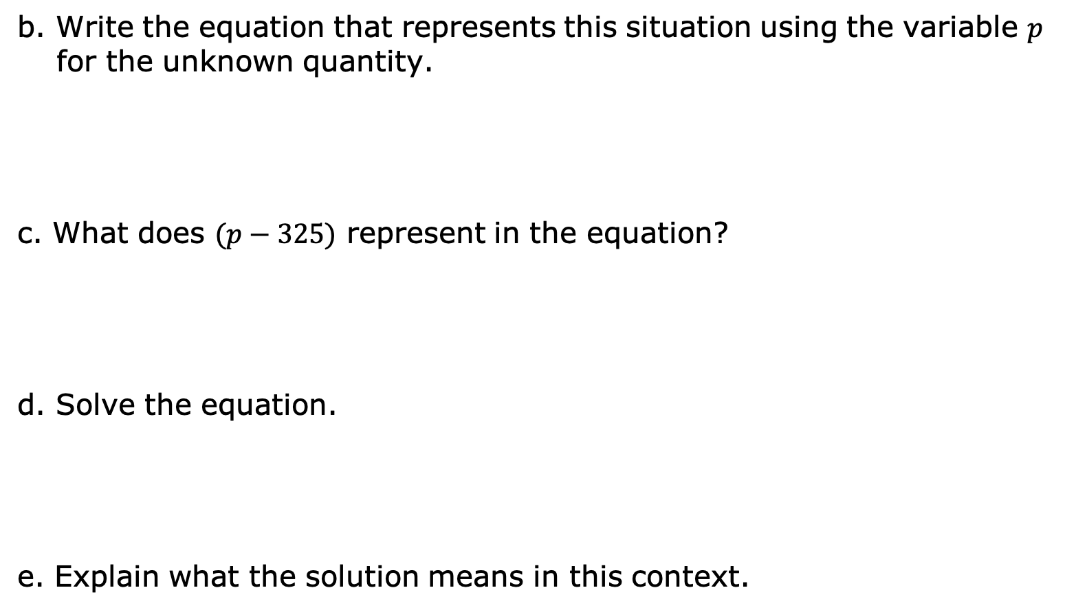
b. Write the equation that represents this situation using the variable $p$ for the unknown quantity.
c. What does $(p−325)$ represent in the equation?
d. Solve the equation.
e. Explain what the solution means in this context.
volume 1, pg. 34

Slide 25

Try It
volume 1, pg. 35

Slide 26

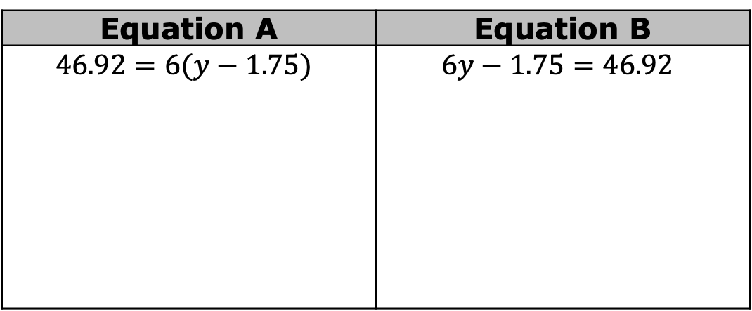
1.5.6 Try It: Relating Equations to Their Contexts
Work with your partner to complete the following.
1. Two equations are shown.
a. Solve both equations. Show your work.
Equation A | Equation B
$$46.92=6(y−1.75)$$ | $$6y−1.75=46.92$$
volume 1, pg. 35

Slide 27
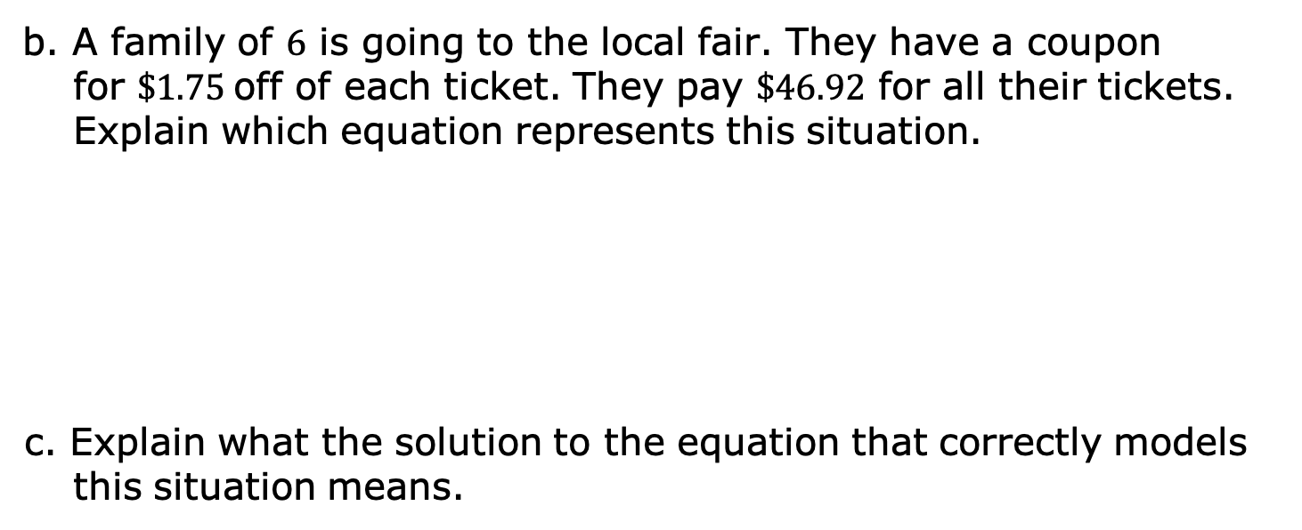
b. A family of $6$ is going to the local fair. They have a coupon for $\$1.75$off of each ticket. They pay $\$46.92$ for all their tickets. Explain which equation represents this situation.
c. Explain what the solution to the equation that correctly models this situation means.
volume 1, pg. 35

Slide 28

Wrap-Up
volume 1, pg. 36

Slide 29
1.5.7 Wrap-Up: Cool Down
Write a summary of what you learned in this lesson.
volume 1, pg. 36

